Slide 1
FINA 1303 FOUNDATIONS OF INTEREST RATES Part I
Veronique Lafon-Vinais
Associate Professor of Business Education - Department of Finance

Slide 2
Course Map
Overview
Foundations of
Interest Rates
Financial Institutions
Pricing of Financial Assets
Regulations
DCF
Sell Side
Buy Side
Stock
Valuation
Banking Regulation
Basics of
Interest Rates
Commercial Banking
Traditional Institutional Investors
Monetary Policy
Investment Banking
Alternative Investors
2

Slide 3
Overview
Foundations of
Interest Rates
DCF
Students will establish an understanding of
Time and the value of payments
Present value versus future value
DCF
Basic Formulas
Basics of
Interest Rates

Slide 4
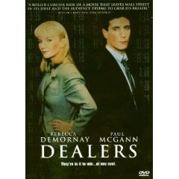
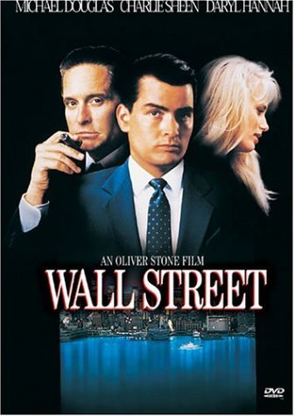
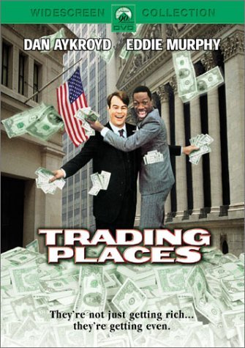
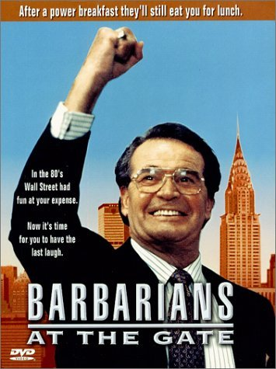
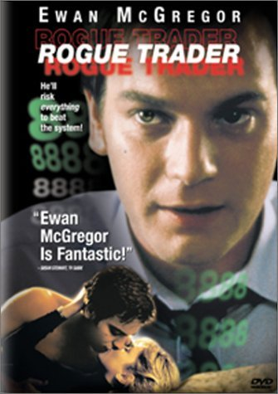
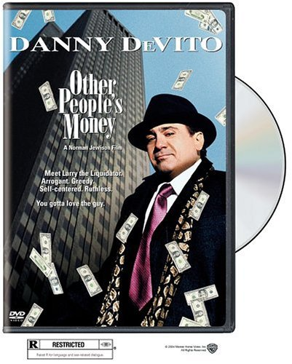

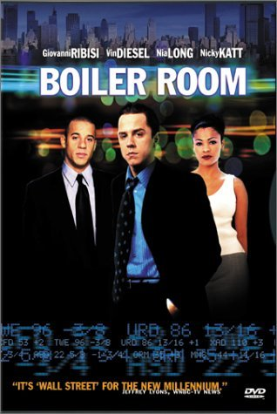
Get a Glimpse: Movies
Notes:
“Trading Places” – funny movie starring Eddie Murphy and Dan Ackroyd – good background information on commodity trading
“Wall Street” – eponymous illustration of the M&A fever and junk bond market starring Michael Douglas
“Boiler Room” – relatively recent movie about penny stock trading in the US –
“Barbarians at the Gate” – the movie from the famous book depicting the giant KKR deal for RJR Nabisco –
“Rogue Trader” – the story of Nick Leeson and the collapse of Barings –
“Other People’s Money” – a funny movie starring Danny De Vito, building on “Wall Street” but as a comedy –
“Glengarry Glen Ross” – a dark satire of the ultra-salesmanship in the world of real estate – but could be similarly applied to sales teams in banks!
“Liar’s Poker” – the movie from the book (the book is much better)-
“Rollover” – not terribly good movie starring Jane Fonda and Kris Kristofferson but provides some background on money & commodity markets and crises –
“Dealers” –

Slide 5

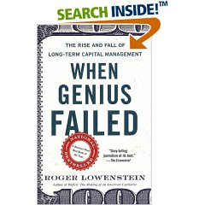
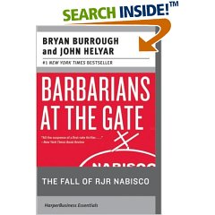
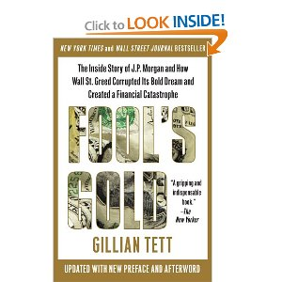
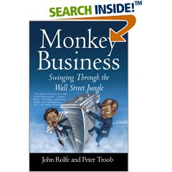

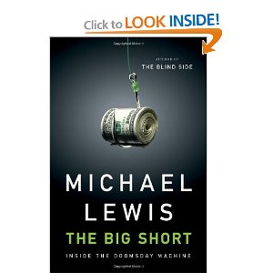

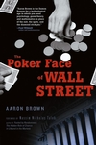

Get a Glimpse: Books
Notes:
“Liar’s Poker” – highly entertaining read about life in fixed income - Lewis describes his four years with the Wall Street firm Salomon Brothers, from his bizarre hiring through the training program to his years as a successful bond trader. Lewis illustrates how economic decisions made at the national level changed securities markets and made bonds the most lucrative game on the Street. His description of the firm's personalities and of the events from 1984 through the crash of October 1987 are vivid and memorable.
“When Genius Failed” – the story of LTCM – Roger Lowenstein's When Genius Failed is the gripping story of the Fed's unprecedented move, the incredible heights reached by LTCM, and the firm's eventual dramatic demise.
“Barbarians at the Gate” – the story of RJR Nabisco and KKR
“Fool’s Gold” excellent story of the financial crisis of 2008 told through the story of the JPM derivatives group. “Tett has the remarkable ability to make swaps, derivatives and their arcane securitized, synthetic offspring understandable to a financially challenged dummy like me and she does it while telling the tale of how this brainstorming group of J.P. Morgan whiz kids came up with a way to make risk, riskless, removing old constraints and unleashing a great wave of capital into the economy that should have been beneficial. But, sadly, it was all too good to be true. When Morgan s rivals combined this financial alchemy with subprime mortgage madness, without considering that a boom could bust, it was all over, leaving us battered by the rippling toxic aftereffects of unregulated greed “
“Monkey Business” – sobering read about life as an associate in an investment bank - As eager-beaver business school students, Rolfe and Troob garnered job offers as junior associates at the elite Wall Street investment bank Donaldson, Lufkin & Jenrette, lured by dreams of wealth, glamour and power. By the time Rolfe and Troob were able to discern the key fact that the "investment banking community has long been an oligopoly, with only a handful of real players with the size and scale to drive through the big deals," they were already grappling with the gritty reality of performing grunt labor in an environment ruled by despotic senior partners who called innumerable meetings to set unrealistic deadlines and make superhuman demands on anybody within screaming distance.
“Hedgehogging” - In Hedgehogging, Biggs offers a fascinating glimpse behind the scenes at the personalities and egos making decisions about the enormous sums being dumped en masse into these funds. It's full of personal anecdotes and critical insights from an insider's insider. You should not even consider giving money to anyone on Wall Street ever again until you've read this book. He discusses investing in general, hedge funds in particular, and how he has learned to find and profit from the best moneymaking opportunities in an eat-what-you-kill, cutthroat investment world.
“The Big Short” Although Lewis is perhaps best known for his sports-related nonfiction (including ), his first book was the autobiographical , in which he chronicled his disillusionment as a young gun on Wall Street in the greed is good 1980s. He returns to his financial roots to excavate the crisis of 2007–2008, employing his trademark technique of casting a microcosmic lens on the personal histories of several Wall Street outsiders who were betting against the grain—to shed light on the macrocosmic tale of greed and fear.
“F.I.A.S.C.O” – another sobering read about an associate’s life, in derivatives this time – FIASCO is the shocking story of one man's education in the jungles of Wall Street. As a young derivatives salesman at Morgan Stanley, Frank Partnoy learned to buy and sell billions of dollars worth of securities that were so complex many traders themselves didn't understand them. In his behind-the-scenes look at the trading floor and the offices of one of the world's top investment firms, Partnoy recounts the macho attitudes and fiercely competitive ploys of his office mates. And he takes us to the annual drunken skeet-shooting competition, FIASCO, where he and his colleagues sharpen the killer instincts they are encouraged to use against their competitors, their clients, and each other.
Traders, guns and money” – fantastic stories on derivatives from an experienced trader and now educator
Other recommendations
“Against the Gods – The Remarkable Story of Risk” – fantastic book about risk in all its aspects – a must read if you’re going to be in markets!
“Goldman Sachs: the culture of success” – book about GS –
“My Life as a Quant” – a recent book about an academic’s foray in the real world of financial markets (!!!!) –
“Predator’s Ball” – the story of junk bonds, DBL and Mike Milken
“Merkin Brothers” – tongue-in-cheek account of the pre-crisis Asian I-banks antics by the editor of Finance Asia – I have a limited supply of books available at the deeply discounted price of HKD 50-

Slide 6
Get a Glimpse: Newsletters and Blogs
General:
Matt Levine “Money Stuff”: https://www.bloomberg.com/opinion/authors/ARbTQlRLRjE/matthew-s-levine
Marc Rubinstein “Net Interest”: https://netinterest.substack.com/
Barry Ritholtz “The Big Picture”: https://ritholtz.com/
John Authers: https://www.bloomberg.com/opinion/authors/AT2bBytfUHQ/john-authers
Corporate Finance:
Vernimmen: http://www.vernimmen.com/ (check out the newsletter)
Damodaran: http://aswathdamodaran.blogspot.com/

Slide 7
FINA 1303 – Basics of financial calculations
Veronique Lafon-Vinais
Associate Professor of Business Education - Department of Finance

Slide 8
Agenda
Part 1: Time Value of Money
Present Value
Future Value
Part 2: Valuing a Stream of Cash Flows
Part 3: Applications
IRR
Mortgages
Basics of Financial Calculations

Slide 9
Interest in History & Islamic Finance
Throughout history, money lenders have been unpopular because they charge interest
Shakespeare’s famous play “The Merchant of Venice” is an illustration of this
Christianity banned the charging of interest (usury) for centuries, and only Jews were involved in providing credit
Today, Islamic Finance prohibits the payment and charging of interest (riba) which is contrary to Islamic laws (sharia). Yet, the Islamic Finance market is growing fast including in Hong Kong, where the HKSAR Government has issued two sukuks (Islamic bonds)

Slide 10
Important things to know before we start!
In this section, unless otherwise indicated, interest rates are yearly (annual) interest rates (in the markets we use the term “per annum” or “p.a.”)
Financial institutions are generally required to indicate the interest rates they charge on an annual percentage rate (APR) basis so that consumers can compare prices
The way we calculate interest payments differs depending on the financial instrument we use. You need to verify the applicable conditions in the contract!
In particular, debt contracts of less than one year and money market securities use simpler formulas (we will discuss this later)
Notes:
Check out money hero website http://www.moneyhero.com.hk/en

Slide 11
Part 1: Time Value of Money

Slide 12
Valuing Monetary Payments now and in the Future: Introducing DCF (“Discounted Cash Flows”)
How do we compare the return on different financial instruments?
Different debt instruments have different streams of cash payments to the holder (known as Cash Flows), with different timing.
How and why is the promise to pay $X on T1 more or less valuable than the promise to pay $Y on T2?
To find out, we use DCF calculations

Slide 13
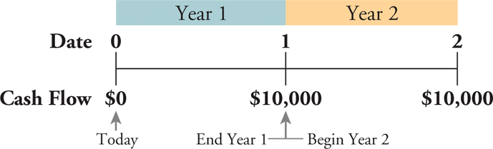
Timelines
Constructing a Timeline
Identifying Dates on a Timeline
Date 0 is today, the beginning of the first year
Date 1 is the end of the first year
Time Value of Money
Copyright ©2015 Pearson Education, Inc. All rights reserved.

Slide 14
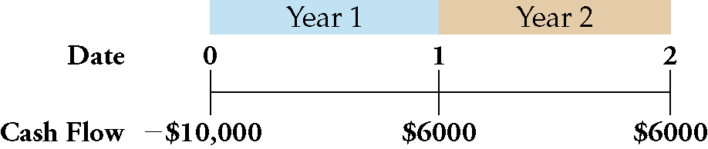
Timelines
Distinguishing Cash Inflows from Outflows (negative signs indicate outflows)
Representing Various Time Periods
Indicate the label :“Year” or “Month” or …..
Time Value of Money
Copyright ©2015 Pearson Education, Inc. All rights reserved.

Slide 15
DCF Introduction
The concept of discounted value is based on the notion (assumption) that a dollar of cash flow paid to you some time from now is less valuable to you than a dollar paid to you today: “a dollar is worth more today than tomorrow” or the time value of money
Why? This notion has been GENERALLY true because you could invest the dollar in a savings account that earns interest
BUT in an era of NEGATIVE interest rates this is no longer true everywhere
We will learn basic pricing of financial instruments under the assumption of positive interest rates. Negative interest rates change significantly our allocation of resources and distort financial markets.

Slide 16
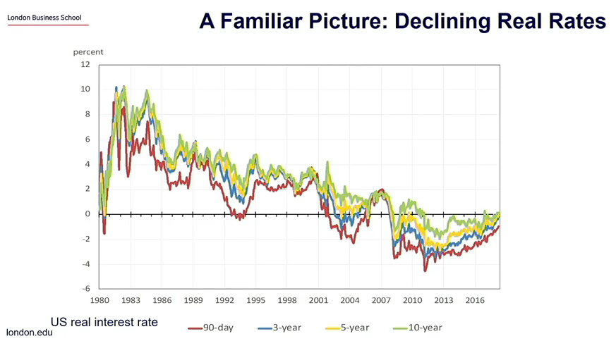
Real Rates
Notes:
Source: LBS Helene Rey ARQ webinar Dec 2020 https://www.youtube.com/watch?v=OMFV-3sJQhw&feature=youtu.be

Slide 17
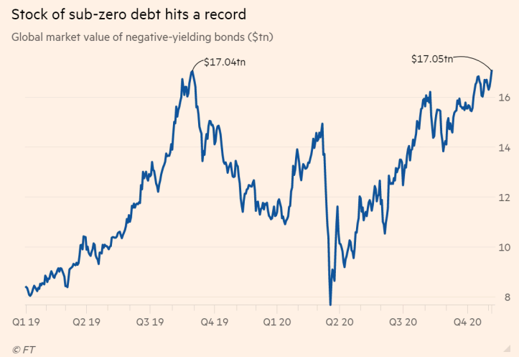
Sub-zero yielding debt reaches $17.05 Tr
Source: FT 7 Nov 2020
Notes:
Source: FT 7 Nov 2020 https://www.ft.com/content/378acc52-b1a5-4d58-8a87-8ea052b2c610?ftcamp=engage%2Femail%2Fnewsletters%2Fsmart_brief%2Fsmartbriefnewsletterscontrafcf%2Fauddev&segid=0800933

Slide 18
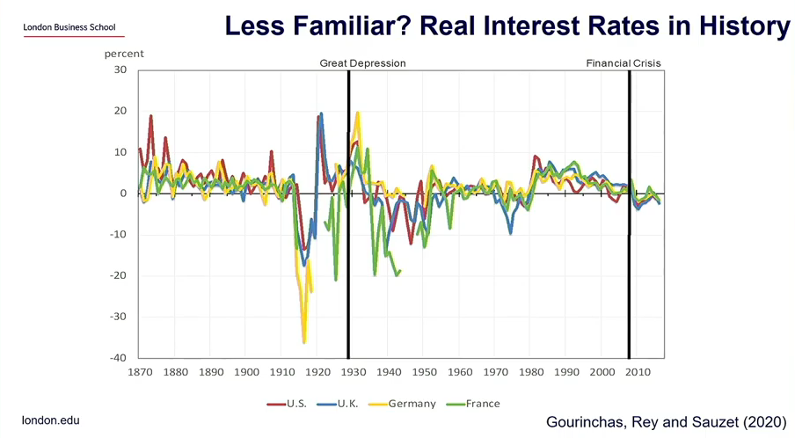
Real Interest Rates in History
Notes:
Source: LBS Helene Rey ARQ webinar Dec 2020 https://www.youtube.com/watch?v=OMFV-3sJQhw&feature=youtu.be

Slide 19
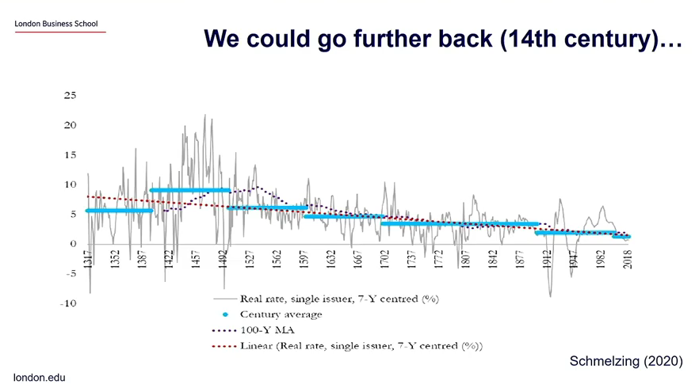
Real Interest Rates a long way back
Notes:
Source: LBS Helene Rey ARQ webinar Dec 2020 https://www.youtube.com/watch?v=OMFV-3sJQhw&feature=youtu.be

Slide 20
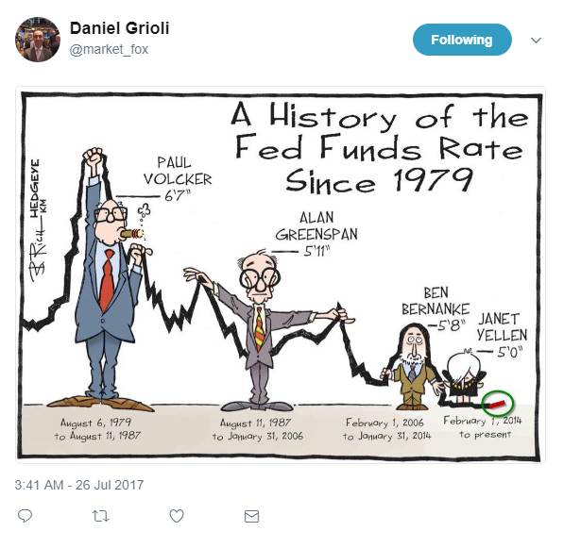
Interest Rates Story
Notes:
Source: LinkedIn https://www.linkedin.com/feed/

Slide 21
Class Discussion
What do you think will happen to interest rates and why?

Slide 22
The Time Value of Money and Interest Rates
The Interest Rate: Converting Cash Across Time
Present Value PV
The value of a cost or benefit computed in terms of cash today
Future Value FV
The value of a cash flow that is moved forward in time
PV
FV
time
today
future
Time Value of Money

Slide 23
Future Value and Interest
Future value is the value on a later date of an investment today.
$100,000 invested today at 10% interest gives $110,000 in a year.
=> the future value of $100,000 today at 10% interest is $110,000 one year from now.
The $100,000 yields $10,000, which is why interest rates are sometimes called yield or yield to maturity.
$100,000
$110,000
time
today
Interest Rate: 10% p.a.
1 year

Slide 24
Future Value example (single period)
Calculate the value of $100,000 Investment in 1 year at a rate of 6% (p.a.)
$100,000
FV?
today
Interest Rate: 6% p.a.
1 year
Time Value of Money

Slide 25
Future Value example (single period)
the cost of the investment is:
($100,000 today) + ($100,000 x 6% p.a.) = $106,000 in one year
We can also express it as:
($100,000 today) × (1.06 $ in one year/$ today) = $106,000 in one year
$106,000 is the opportunity cost of spending $100,000 today
The firm gives up the $106,000 it would have had in one year if it had left the money in the bank
Alternatively, by borrowing the $100,000 from the same bank, the firm would owe $106,000 in one year.

Slide 26
Future Value example (single period)
Calculate the value of $100,000 Investment in 1 year at a rate of 6% (p.a.)
Present value PV
Future value FV
$100,000
106,000
today
Interest Rate r: 6% p.a.
1 year
Number of periods n = 1 year
Time Value of Money

Slide 27
Future Value and Interest (single period)
Notice that
If the interest rate r is 10%, the future value FV in one year is:
$100,000 + ($100,000 x 0.10) = $110,000
If the interest rate r is 6%, the future value FV in one year is:
$100,000 + ($100,000 x 0.06) = $106,000
The higher the interest rate, the higher the future value.
FV = PV + PV x r = PV x (1 + r)

Slide 28
Future Value and Compound Interest
The higher the interest rate, the higher the future value.
The higher the amount invested, the higher the future value.
Most financial instruments are not so simple, so what happens when time to repayment varies?
When using one-year interest rates to compute the value repaid more than one year from now, we must consider compound interest.
Compound interest is the interest on the interest.

Slide 29
Future Value and Compound Interest
What if you leave your $100 in the bank for two years at 6% yearly interest rate?
Yearly: Calculated and credited at the end of each year!
The future value is:
$100 + ($100 x 0.06) + ($100 x 0.06) + ($6 x 0.06) = $112.36
$100 x 1.06 x 1.06 = $100 x (1.06)²
In general
FV_{n} = PV x(1 + r)^{n}

Slide 30
Future Value and Compound Interest

Slide 31
Future Value and Compound Interest

Slide 32
Pop Quiz!
The time value of money: “a dollar is worth _____today than tomorrow”
The higher the interest rate, the ______ the future value.
The higher the amount invested, the ______ the future value.
Present Value = The value of a cost or benefit computed in terms of cash _____
Compound interest is _________________

Slide 33
Compounding Frequency
If the annual interest rate is 6%, what is the equivalent monthly rate if interests are calculated and credited on a monthly basis?
Assume j is a one-month interest rate and n is the number of months, then a one year (n = 12) deposit of $100 will have a future value of: $100 x (1 + j)¹².

Slide 34
Compounding Frequency
In one year the future value is $100 x 1.06 so we can find j:
(1 + j)¹² = 1.06
(1 + j) = (1.06)^{1/12} = 1.0049
j = 0.49% = 49bp
A basis point (bp) is one one-hundredth of a percentage point, 0.01 percent.

Slide 35
Changing Compounding Frequency
The frequency of the compounding (calculating and crediting interest) changes substantially the future value
What if compounding is:
12% annual,
6% semi-annual,
3% quarterly,
1% monthly?

Slide 36
Changing Compounding Frequency

Slide 37
Changing Compounding Frequency
With higher interest rates, the difference from a higher compounding frequency is even larger

Slide 38
Present Value
Financial instruments promise future cash payments. Valuing those payments under the same or consistent assumptions enables us to compare several alternatives.
Present value is the value today of a payment to be made in the future.
Present value is the equivalent amount to invest today in order to be equal to a specific amount on a given future date.

Slide 39

Present Value for 1 Period
Knowing the Future Value, we can find easily the Present Value:
FV = PV x (1+r), so
PV=
This is just the future value calculation inverted.
$$\frac{FV}{(1+r)}$$

Slide 40

Present Value for n Periods
We can generalize the process as we did for future value.
Present Value of one payment credited n years in the future, but calculated at the end of each year:
PV =
$$\frac{FV}{{(1+r)}^{n}}$$

Slide 41
Present Value: THE Basis for DCF
The present value is higher:
The higher future value of the payment, FVn.
The shorter time period until payment, n.
The lower the interest rate, r.
Present value is the single most important relationship in our study of financial instruments. It is THE basis for Discounted Cash Flows analysis.

Slide 42
Present Value as a Function of Tenor

Slide 43
Present Value of $100 Payment
Higher interest rates are associated with lower PV no matter the timing of the payment.
At any interest rate, a longer tenor reduces PV.
For 1% interest rate variation, the difference in PV varies with rate and tenor: Convexity
Present Value

Slide 44
Example 1: Comparing Revenues at Different Points in Time
Problem:
The launch of Sony’s PlayStation 3 was delayed until November 2006, giving Microsoft’s Xbox 360 a full year on the market without competition. Sony did not repeat this mistake in 2013 when the PS4 launched at the same time as the Xbox One.
It is November 2005 and you are the marketing manager for the PlayStation. You estimate that if the PlayStation 3 were ready to be launched immediately, you could sell $2 billion worth of the console in its first year.
However, if your launch is delayed a year, you believe that Microsoft’s head start will reduce your first-year sales by 20% to $1.6 billion.
If the interest rate is 8%, what is the cost of a delay in terms of dollars in 2005?
Time Value of Money
Copyright ©2015 Pearson Education, Inc. All rights reserved.

Slide 45
Example 1: Comparing Revenues at Different Points in Time
Solution:
Plan:
Revenues if released today: $2 billion
Revenue if delayed: $1.6 billion
Interest rate: 8%
We need to compute the revenues if the launch is delayed and compare them to the revenues from launching today.
However, in order to make a fair comparison, we need to convert the future revenues of the PlayStation if delayed into an equivalent present value of those revenues today.
Time Value of Money
Copyright ©2015 Pearson Education, Inc. All rights reserved.

Slide 46

Example 1: Comparing Revenues at Different Points in Time
Execute:
If the launch is delayed to 2006, revenues will drop by 20% of $2 billion, or $400 million, to $1.6 billion.
To compare this amount to revenues of $2 billion if launched in 2005, we must convert it using the interest rate of 8% (this is calculating the present value of the $1.6Bn):
$1.6 billion/1.08 = $1.481 billion in 2005
Therefore, the cost of a delay of one year is
$2 billion - $1.481 billion = $0.519 billion ($519 million).
In other words, we multiply the future value ($1.6Bn) by the discount factor (1/1+r) to get the present value
PV =
$$\frac{FV}{{(1+r)}^{n}}$$
Time Value of Money
Copyright ©2015 Pearson Education, Inc. All rights reserved.

Slide 47
Example 1: Comparing Revenues at Different Points in Time
Nov 2005
Nov 2006
Nov 2007
0
1
2
(1) $2 Bn
(2) $1.481 Bn
(2) $1.6 Bn

Slide 48
Example 1: Comparing Revenues at Different Points in Time
Evaluate:
Delaying the project for one year was equivalent to giving up $519 million in cash.
In this example, we focused only on the effect on the first year’s revenues. However, delaying the launch delays the entire revenue stream by one year, so the total cost would be calculated in the same way by summing the cost of delay for each year of revenues.
Time Value of Money
Copyright ©2015 Pearson Education, Inc. All rights reserved.

Slide 49

Your Turn!
Problem:
The launch of Sony’s PlayStation 3 was delayed until November 2006, giving Microsoft’s Xbox 360 a full year on the market without competition.
It is November 2005 and you are the marketing manager for the PlayStation. You estimate that if the PlayStation 3 were ready to be launched immediately, you could sell $3 billion worth of the console in its first year.
However, if your launch is delayed a year, you believe that Microsoft’s head start will reduce your first-year sales by 35%.
If the interest rate is 6%, what is the cost of a delay in terms of dollars in 2005?
Time Value of Money
Copyright ©2015 Pearson Education, Inc. All rights reserved.

Slide 50

Your Turn! (PRS, please)
The cost of delay is
$519 million
$1.160 billion
$2 billion
I don’t care I don’t like video games
Time Value of Money

Slide 51
Solution to Example: Comparing Revenues at Different Points in Time
Solution:
Plan:
Revenues if released today: $3 billion,
Revenue decrease if delayed: 35% ,
Interest rate: 6%
We need to compute the revenues if the launch is delayed and compare them to the revenues from launching today.
However, in order to make a fair comparison, we need to convert the future revenues of the PlayStation if delayed into an equivalent present value of those revenues today.
Time Value of Money
Copyright ©2015 Pearson Education, Inc. All rights reserved.

Slide 52

Solution to Example: Comparing Revenues at Different Points in Time
Execute:
If the launch is delayed to 2006, revenues will drop by 35% of $3 billion, or $1.05 billion, to $1.95 billion.
To compare this amount to revenues of $3 billion if launched in 2005, we must convert it using the interest rate of 6%:
$1.95 billion/1.06 = $1.840 billion in 2005
Therefore, the cost of a delay of one year is
$3 billion - $1.840 billion = $1.160 billion
PV =
$$\frac{FV}{{(1+r)}^{n}}$$
Time Value of Money
Copyright ©2015 Pearson Education, Inc. All rights reserved.

Slide 53
Solution to Example: Comparing Revenues at Different Points in Time
Evaluate:
Delaying the project for one year was equivalent to giving up $1.16 billion in cash.
In this example, we focused only on the effect on the first year’s revenues.
However, delaying the launch delays the entire revenue stream by one year, so the total cost would be calculated in the same way by summing the cost of delay for each year of revenues.
Time Value of Money
Copyright ©2015 Pearson Education, Inc. All rights reserved.

Slide 54
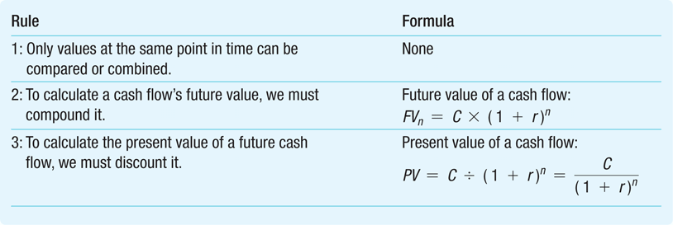
The Three Rules of Valuing Cash Flows
Time Value of Money
Copyright ©2015 Pearson Education, Inc. All rights reserved.

Slide 55
Valuing Cash Flows at Different Points in Time
Rule 1: Comparing and Combining Values
It is only possible to compare or combine values at the same point in time
Time Value of Money
Copyright ©2015 Pearson Education, Inc. All rights reserved.

Slide 56
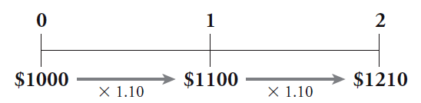
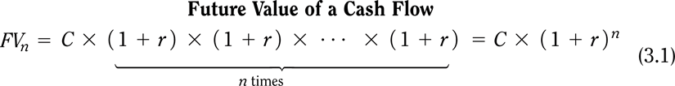
Valuing Cash Flows at Different Points in Time
Rule 2: Compounding
To calculate a cash flow’s future value, you must compound it
Compound Interest = The effect of earning “interest on interest”
Time Value of Money
Copyright ©2015 Pearson Education, Inc. All rights reserved.

Slide 57
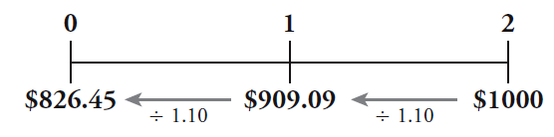
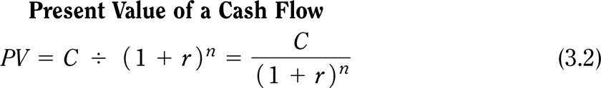
Valuing Cash Flows at Different Points in Time
Rule 3: Discounting
To calculate the value of a future cash flow at an earlier point in time, we must discount it.
Time Value of Money
Copyright ©2015 Pearson Education, Inc. All rights reserved.

Slide 58
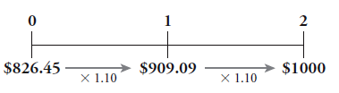

Valuing Cash Flows at Different Points in Time
Rule 3: Discounting & Compounding - Example
If $826.45 is invested today for two years at 10% interest, the future value will be $1,000-
If $1,000- were three years away, the present value, if the interest rate is 10%, would be $751.31
Time Value of Money
Copyright ©2015 Pearson Education, Inc. All rights reserved.

Slide 59
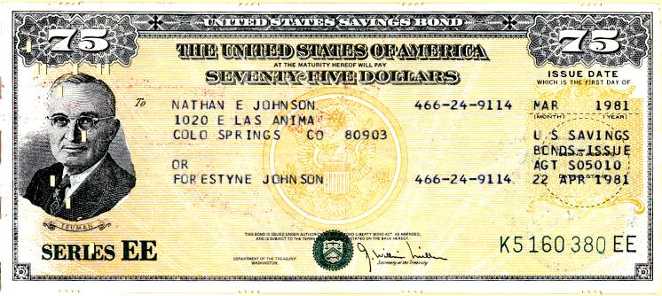
Example: Present Value of a Single Future Cash Flow
Problem:
You are considering investing in a savings bond that will pay $15,000 in 10 years.
If the competitive market interest rate is fixed at 6% per year, what is the bond worth today?
Time Value of Money
Copyright ©2015 Pearson Education, Inc. All rights reserved.

Slide 60
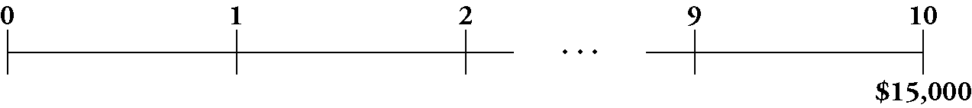
Example: Present Value of a Single Future Cash Flow
Solution:
First set up your timeline. The cash flows for this bond are represented by the following timeline:
Thus, the bond is worth $15,000 in 10 years. To determine the value today, we compute the present value using the PV equation and our interest rate of 6%.
Where C is the single cash flow – in this case, it’s also the Future Value
Time Value of Money
Copyright ©2015 Pearson Education, Inc. All rights reserved.

Slide 61





Example: Present Value of a Single Future Cash Flow
Execute:
Using the financial calculator we can input the relevant variables
Given: | 10 | 6 |  | 0 | 15,000
Solve for: |  |  | -8,375.92
Excel Formula: =PV(RATE,NPER, PMT, FV) = PV(0.06,10,0,15000)
Time Value of Money
Copyright ©2015 Pearson Education, Inc. All rights reserved.

Slide 62
Example: Present Value of a Single Future Cash Flow
Evaluate:
The bond is worth much less today than its final payoff because of the time value of money.
Food for thought:
What if interest rates were lower?
Time Value of Money
Copyright ©2015 Pearson Education, Inc. All rights reserved.

Slide 63
Your Turn!
Problem:
XYZ Company expects to receive a cash flow of $2 million in five years.
If the competitive market interest rate is fixed at 4% per year, how much can they borrow today in order to be able to repay the loan in its entirety with that cash flow?
Time Value of Money
Copyright ©2015 Pearson Education, Inc. All rights reserved.

Slide 64
Your Turn! (PRS, please)
We can borrow
$1.5 million
$1.6 million
$2 million
Borrowing is bad, it leads to trouble!
Time Value of Money

Slide 65

Solution to Example: Present Value of a Single Future Cash Flow
Solution:
First set up your timeline. The cash flows for the loan are represented by the following timeline:
Thus, XYZ Company will be able to repay the loan with its expected $2 million cash flow in five years. To determine the value today, we compute the present value using our interest rate of 4%.
Where C is the single cash flow – in this case, it’s also the Future Value
Time Value of Money
Copyright ©2015 Pearson Education, Inc. All rights reserved.

Slide 66

Solution to Example: Present Value of a Single Future Cash Flow
Execute:
Using the financial calculator we can input the relevant variables
Given: | 5 | 4 |  | 0 | 2,000,000
Solve for: |  |  | -1,643,854.21
Excel Formula: =PV(RATE,NPER, PMT, FV) = PV(0.04,5,0,2000000)
Time Value of Money
Copyright ©2015 Pearson Education, Inc. All rights reserved.

Slide 67
Solution to Example: Present Value of a Single Future Cash Flow
Evaluate:
The loan is much less than the $2 million the company will pay back because of the time value of money.
Time Value of Money
Copyright ©2015 Pearson Education, Inc. All rights reserved.

Slide 68
Part 2: Valuing a Stream of Cash Flows

Slide 69
Valuing a Stream of Cash Flows
Applying the Rules of Valuing Cash Flows
Suppose we plan to save $1,000 today, and $1,000 at the end of each of the next two years
If we earn a fixed 10% interest rate on our savings, how much will we have three years from today (future value)?
We can do this in several ways
First, take the deposit at date 0 and move it forward to date 1
Combine those two amounts and move the combined total forward to date 2
Valuing a Stream of Cash Flows
Copyright ©2015 Pearson Education, Inc. All rights reserved.

Slide 70
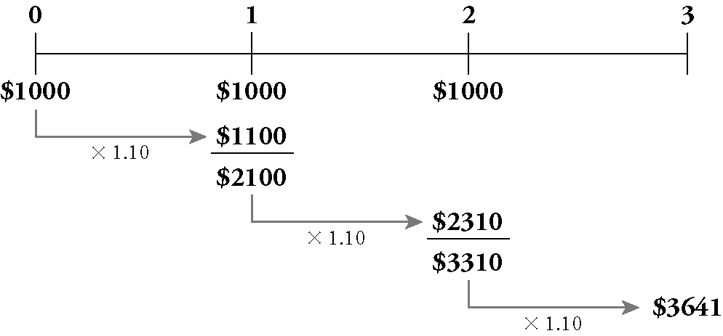
Valuing a Stream of Cash Flows
Continuing in the same fashion, we can solve the problem as follows:
Valuing a Stream of Cash Flows
Copyright ©2015 Pearson Education, Inc. All rights reserved.

Slide 71
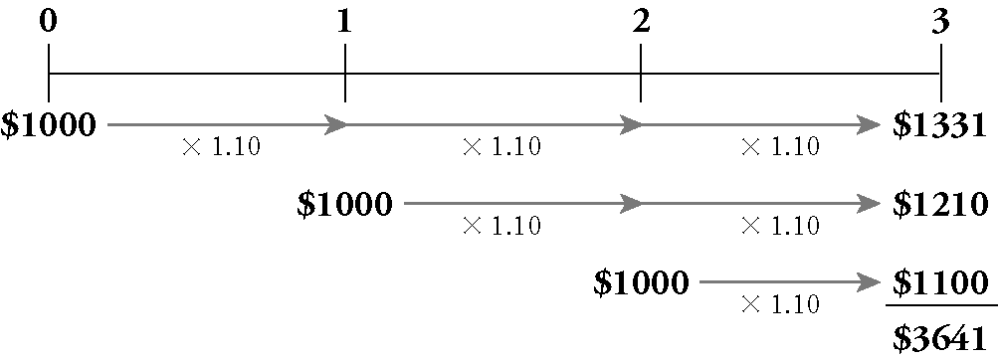
Valuing a Stream of Cash Flows
Another approach is to compute the future value in year 3 of each cash flow separately
Once all amounts are in year 3 dollars, combine them
Valuing a Stream of Cash Flows
Copyright ©2015 Pearson Education, Inc. All rights reserved.

Slide 72
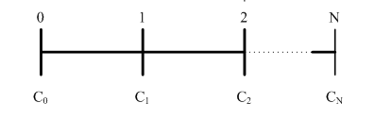
Valuing a Stream of Cash Flows
Consider a stream of cash flows: C₀ at date 0, C₁ at date 1, and so on, up to C_{N} at date N
We compute the present value of this cash flow stream in two steps
Valuing a Stream of Cash Flows
Copyright ©2015 Pearson Education, Inc. All rights reserved.

Slide 73
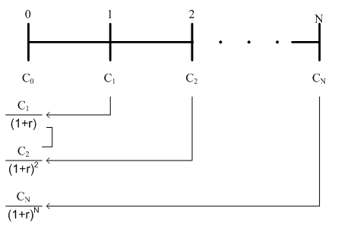
Valuing a Stream of Cash Flows
First, compute the present value of each cash flow
Then combine the present values: the PV of a stream of cash flows is the sum of the present values of each cash flow
Valuing a Stream of Cash Flows
Copyright ©2015 Pearson Education, Inc. All rights reserved.

Slide 74

Valuing a Stream of Cash Flows
The present value of a cash flow stream is the sum of the present values of each cash flow
Valuing a Stream of Cash Flows

Slide 75
Your Turn!
Problem:
You have just graduated and need money to buy a laptop
Your aunt will lend you the money so long as you agree to pay her back within six years.
You offer to pay her the rate of interest that she would otherwise get by putting her money in a savings account.
Based on your earnings and living expenses, you think you will be able to pay her $70 next year, $85 in each of the next two years, and then $90 each year for years 4 through 6.
If your aunt would otherwise earn 0.5% per year on her savings, how much can you borrow from her?
Valuing a Stream of Cash Flows
Copyright ©2015 Pearson Education, Inc. All rights reserved.

Slide 76
Your Turn! (PRS, please)
We can borrow
$600.7
$500.9
$400.5
Borrowing is bad, it leads to trouble!
Valuing a Stream of Cash Flows

Slide 77
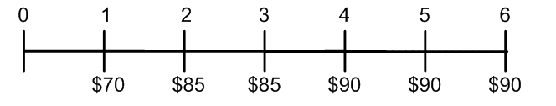
Solution : Present Value of a Stream of Cash Flows
Plan:
The cash flows you can promise your aunt are as follows:
She should be willing to give you an amount equal to these payments in present value terms.
Valuing a Stream of Cash Flows
Copyright ©2015 Pearson Education, Inc. All rights reserved.

Slide 78
Solution : Present Value of a Stream of Cash Flows (cont’d)
Plan:
We will:
Solve the problem using the equation
the present value of a series of cash flows is the sum of the present values of each of the cash flows; so we calculate the present value of each cash flow and add up all the present values
Verify our answer by calculating the future value of this amount.
Valuing a Stream of Cash Flows
Copyright ©2015 Pearson Education, Inc. All rights reserved.

Slide 79
Solution : Present Value of a Stream of Cash Flows (cont’d)
Execute:
We can calculate the PV as follows:
Valuing a Stream of Cash Flows
Copyright ©2015 Pearson Education, Inc. All rights reserved.

Slide 80
Solution : Present Value of a Stream of Cash Flows (cont’d)
Part 2
Now, suppose that your aunt gives you the money, and then deposits your payments in the bank each year.
How much will she have six years from now?
Valuing a Stream of Cash Flows
Copyright ©2015 Pearson Education, Inc. All rights reserved.

Slide 81
Your Turn! (PRS, please)
She will have
$600
$516
$475
Valuing a Stream of Cash Flows

Slide 82
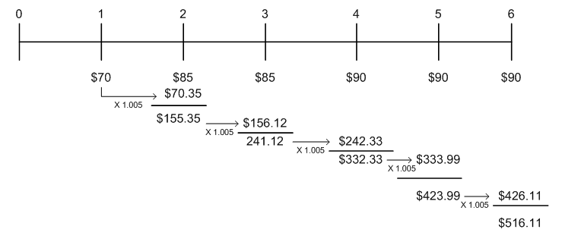
Solution : Present Value of a Stream of Cash Flows (cont’d)
Execute:
We need to compute the future value of the yearly deposits.
One way is to compute the bank balance each year.
Valuing a Stream of Cash Flows
Copyright ©2015 Pearson Education, Inc. All rights reserved.

Slide 83
Solution : Present Value of a Stream of Cash Flows (cont’d)
Execute:
To verify our answer, suppose your aunt kept her $500.90 in the bank today earning 0.5% interest.
In six years she would have:
FV = $500.90×(1.005)⁶= $516.11 in 6 years
Valuing a Stream of Cash Flows
Copyright ©2015 Pearson Education, Inc. All rights reserved.
Notes:
Thus, your aunt should be willing to lend you $500.90 in exchange for your promised payments.
This amount is less than the total you will pay her ($70+$85+$85+$90+$90+$90=$510) due to the time value of money.

Slide 84
Your Turn!
Problem:
We plan to save $1,000 today and at the end of each of the next two years.
At a fixed 6% interest rate, how much will we have in the bank three years from today?
Valuing a Stream of Cash Flows
Copyright ©2015 Pearson Education, Inc. All rights reserved.

Slide 85
Your Turn! (PRS, please)
We will have
$3,505.5
$2,833.4
$3,374.6
Valuing a Stream of Cash Flows

Slide 86
Solution : Computing the Future Value (cont’d)
Plan:
We’ll start with the timeline for this savings plan:
First we’ll compute the present value of the cash flows.
Then we’ll compute its value three years later (its future value).
Valuing a Stream of Cash Flows
Copyright ©2015 Pearson Education, Inc. All rights reserved.

Slide 87
Solution : Computing the Future Value (cont’d)
Execute:
This is how we’ve done it so far – this works no matter the cash flows
Valuing a Stream of Cash Flows
Copyright ©2015 Pearson Education, Inc. All rights reserved.

Slide 88
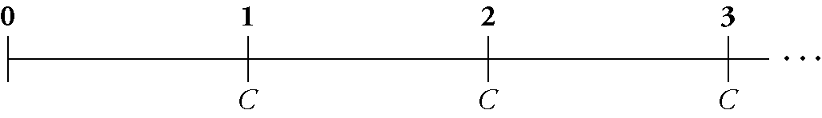
Perpetuities
Examples?
Perpetuities (also called consols)
A perpetuity is a stream of equal cash flows that occur at regular intervals and last forever
Here is the timeline for a perpetuity:
the first cash flow does not occur immediately; it arrives at the end of the first period
Perpetuities
Copyright ©2015 Pearson Education, Inc. All rights reserved.
Notes:
Examples include endowments, perpetual bonds

Slide 89
Perpetuities
Using the formula for present value, the present value of a perpetuity with payment C and interest rate r is given by:
Notice that all the cash flows are the same
Also, the first cash flow starts at time 1 (not 0)
Perpetuities
Copyright ©2015 Pearson Education, Inc. All rights reserved.

Slide 90

Perpetuities/Consols
Present Value of a Perpetuity
This formula only works when r is positive!
Perpetuities
Copyright ©2015 Pearson Education, Inc. All rights reserved.

Slide 91
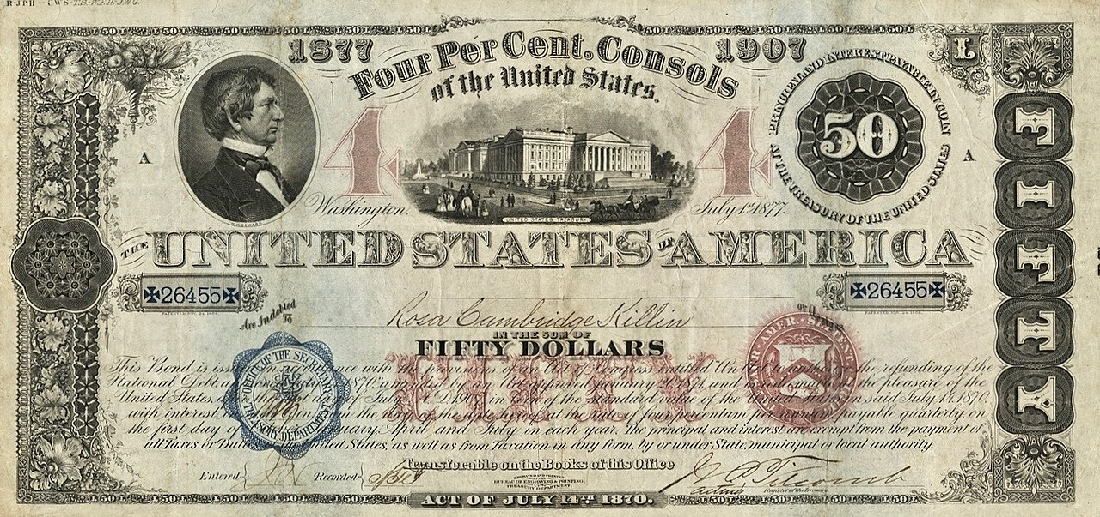
Example of consol
Perpetuities
Notes:
Source: Wikipedia https://commons.wikimedia.org/wiki/File:1877_4%25_$50_United_States_Consols_.jpg#/media/File:1877_4%_$50_United_States_Consols_.jpg
Consols were issued by the UK (1750s) and the US government (1870s). All the outstanding US consols were redeemed by 2015.
Consol (short for consolidated) bonds were issued by the U.S. Treasury during the 19th and early 20th Centuries. Used to refinance the national debt, the 41st Congress passed an act in 1870 authorizing three separate consol issues with redemption privileges after ten, fifteen, and thirty years. Unlike traditional debt issuances, consols have no definitive redemption dates. It is from this feature that they are occasionally referred to as "perpetual bonds." They are redeemable at the pleasure of the Treasury Department after a specified date. Several nations have issued sovereign consols. The interest rates on these securities are such that governments have often left consols outstanding for decades. In 2014, the British government redeemed 4% consols issued to pay for the costs of WWI. The Acts of July 14th, 1870, and January 20, 1871 provided authorization for the issuance of $1 billion of thirty-year consols, exempted from all local, state, and federal taxation. The Herbstman Collection features the only known examples of registered bonds authorized by the act. These bonds were referred to as the Funded Loan of 1907.
877 $50 Thirty-year Registered 4% Consol
$740 Million Issued
Like other sovereign-issue consols, this debt security has no definitive payable date. The bond is redeemable at the pleasure of the Treasury Department after July of 1907. This security, known on the government's books as the Funded Loan of 1907, was issued between 1877-1879. The interest on this security was paid quarterly: January, April July, and October. The back of this security features the Treasury's transfer form for registered bonds. Also featured are two parallel blue-colored anti-counterfeiting swaths imbedded within the paper itself.
The only $50 registered consol known to exist from this year, and one of two registered 1877 Consols known

Slide 92

Your Turn!
Problem:
You just won the lottery, and you want to endow a professorship at your alma mater.
You are willing to donate $4 million of your winnings for this purpose.
If the university earns 5% per year on its investments, and the professor will be receiving her first payment in one year, how much will the endowment pay her each year?
Perpetuities
Copyright ©2015 Pearson Education, Inc. All rights reserved.

Slide 93
Your Turn! (PRS, please)
The endowment will pay
$200,000
$283,334
$337,456
Perpetuities

Slide 94
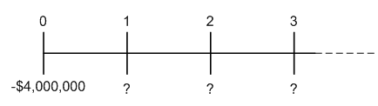
Solution : Endowing a Perpetuity
Plan:
The timeline of the cash flows you want to provide is:
This is a standard perpetuity. The amount she can withdraw each year while keeping the principal intact is the cash flow C when solving the equation:
Perpetuities
Copyright ©2015 Pearson Education, Inc. All rights reserved.

Slide 95


Solution : Endowing a Perpetuity (cont’d)
Execute:
From the formula for a perpetuity,
Perpetuities
Copyright ©2015 Pearson Education, Inc. All rights reserved.
Notes:
If you donate $4,000,000 today, and if the university invests it at 5% per year forever, then the chosen professor will receive $200,000 every year.

Slide 96
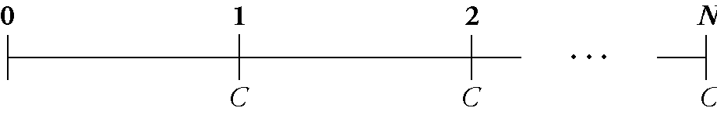
Annuities
Examples?
Annuities (also called fixed payment loans)
An annuity is a stream of N equal cash flows C paid at regular intervals
The difference between an annuity and a perpetuity is that an annuity ends after some fixed number of payments (N)
Annuities
Copyright ©2015 Pearson Education, Inc. All rights reserved.
Notes:
Most obvious one is mortgages, but also savings plans

Slide 97
Annuities
Present Value of An Annuity
Note that, just as with the perpetuity, we assume the first payment takes place one period from today (time 1)
Annuities
Copyright ©2015 Pearson Education, Inc. All rights reserved.

Slide 98
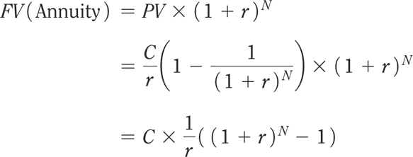
Annuities
Future Value of an Annuity
Annuities
Copyright ©2015 Pearson Education, Inc. All rights reserved.

Slide 99
In Practice: Mortgages
If you consider the cash flows for a fixed rate mortgage with annual repayments, that is exactly that formula.
C is your annual payment (installments), including some interests and some capital repayment (PMT in Excel or HP12C),
n is the number of years (NPER in Excel or n in HP12C),
r is the interest rate (RATE in Excel or i in HP12C)
And PV is the amount initially borrowed (PV in Excel or HP12C)
(FV = 0 in both, type being End (credited at end of period) )
Annuities

Slide 100
In Practice: Fixed Rate Mortgage
For this mortgage:
The amortization table would be:
Annuities
Notes:
In order to make things easier for borrowers as well as reduce credit risk over time for lenders, mortgage payments have been structured so that ALL the periodical payments are equal.
On T=0, the Amount Due is FV
On T=1 when PMT is paid, it is in fact {FV x i} in interests for past period and {PMT – FV x i} in principal repaid
On T=2 the Amount Due is lower because of piece of principal repaid and the same calculations apply again….
That is how you can calculate your amortization table to know the Amount Due at any time

Slide 101
Your Turn!
Problem:
Your parents have made you an offer you can’t refuse.
They’re planning to give you part of your inheritance early (!).
They’ve given you a choice.
Option a: They’ll pay you $10,000 per year for each of the next seven years (beginning today, last payment at the end of the 7th year)
Option b: they’ll give you their BMW Convertible, which you can sell for $61,000 (guaranteed) today.
If you can earn 7% annually on your investments, which should you choose?
Annuities
Copyright ©2015 Pearson Education, Inc. All rights reserved.

Slide 102
Your Turn! (PRS, please)
We should choose
A
B
Annuities

Slide 103
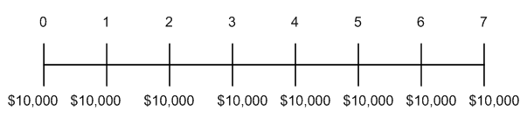
Solution : Present Value of an Annuity
Plan:
Option (a) provides $10,000 paid over time. To evaluate it correctly, we must convert it to a present value. Here is the timeline:
The $10,000 at date 0 is already stated in present value terms, but we need to compute the present value of the remaining payments.
Fortunately, this case looks like a 7-year annuity of $10,000 per year, so we can use the annuity formula.
Annuities
Copyright ©2015 Pearson Education, Inc. All rights reserved.

Slide 104

Solution : Present Value of an Annuity (cont’d)
Execute:
PV = 53,892.89
Annuities
Copyright ©2015 Pearson Education, Inc. All rights reserved.

Slide 105
Solution : Present Value of an Annuity (cont’d)
Execute (cont’d):
Thus, the total present value of the cash flows is $10,000 + 53,892.89 = $63,892.89 which is more than the value of the car. In timeline form:
0
1
2
3
4
5
6
7
10,000
10,000
10,000
10,000
10,000
10,000
10,000
10,000
53,892.89
63,892.89
Annuities
Copyright ©2015 Pearson Education, Inc. All rights reserved.

Slide 106
Solution : Present Value of an Annuity (cont’d)
Execute (cont’d):
Financial calculators or Excel can handle annuities easily—just enter the cash flow in the annuity as the PMT:
Given: | 7 | 7 |  | 10000 | 0
Solve for: |  |  | -53,892.89
Excel Formula: =PV(RATE,NPER, PMT, FV) = PV(0.07,7,10000,0)
Annuities
Copyright ©2015 Pearson Education, Inc. All rights reserved.

Slide 107
Your Turn!
Problem:
Adam is 25 years old, and he has decided it is time to plan seriously for his retirement.
He will save $10,000 in a retirement account at the end of each year until he is 45.
At that time, he will stop paying into the account, though he does not plan to retire until he is 65.
If the account earns 10% per year, how much will Adam have saved at age 65?
Annuities
Copyright ©2015 Pearson Education, Inc. All rights reserved.

Slide 108
Your Turn! (PRS, please)
Adam will have saved
$572,750
$1,545,250
$3,853,715
Annuities

Slide 109
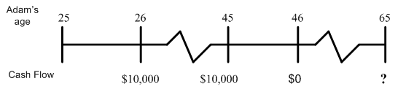
Solution : Retirement Savings Plan Annuity
Solution:
Plan:
As always, we begin with a timeline. In this case, it is helpful to keep track of both the dates and Adam’s age:
Annuities
Copyright ©2015 Pearson Education, Inc. All rights reserved.

Slide 110
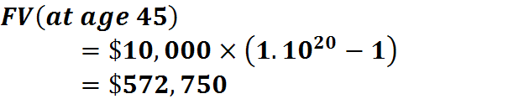


Solution : Retirement Savings Plan Annuity
Execute:
Using Financial calculators or Excel:
X 1/0.10
Given: | 20 | 10.0 | 0 | -10,000
Solve for: |  |  |  |  | $572,750
Excel Formula: =FV(RATE,NPER, PMT, PV) = FV(0.10,20,-10000,0)
Copyright ©2015 Pearson Education, Inc. All rights reserved.
Notes:
Adam’s savings plan looks like an annuity of $10,000 per year for 20 years.
The money will then remain in the account until Adam is 65 => 20 more years.
To determine the amount Adam will have in the bank at age 45, we’ll need to compute the future value of this annuity.
Then we’ll compound the future value into the future 20 more years to see how much he’ll have at 65.

Slide 111
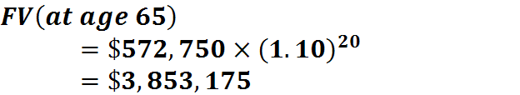
Solution : Retirement Savings Plan Annuity
Execute:
Using Financial calculators or Excel:
Given: | 20 | 10.0 | -$572,750 | 0
Solve for: |  |  |  |  | $3,853,175
Excel Formula: =FV(RATE,NPER, PMT, PV) = FV(0.10,20,0,-572750)
Annuities
Copyright ©2015 Pearson Education, Inc. All rights reserved.

Slide 112
Part 3: Applications

Slide 113
Application 1: Your Credit Card in Hong Kong
Check out your credit card statement
What does it show at the end of the statement?
Why do you think the financial regulators are forcing the credit card issuers to include this information?

Slide 114
Credit Cards “Easy Money”: Pay Fast!
Credit cards are useful, but sometimes too easy.

Slide 115
Applying PV : Example - calculating the Internal Rate of Return
Imagine that you run a toy manufacturing company and that you are considering purchasing a new machine.
Machine costs $4 million and can produce 50,000 toys per year.
You sell the toys for $10, generating $500,000 in revenue per year.
Assume that the machine is the only input, you have certainty about the revenue, there is no maintenance and the machine has a 10 year lifespan.

Slide 116
Internal Rate of Return: Example
If you borrow $4 million, is the revenue enough to make the payments?
We need to calculate the internal rate of return (IRR) of this investment:
It is the interest rate that equates the present value from the cash flow of an investment with its cost.

Slide 117
Internal Rate of Return: Example
Balance the cost of the machine against the revenue.
$4 million today versus $500,000 a year for ten years.
At the internal rate of return, the cost of the machine is equal to the present value of all the yearly revenues.
Solve for i - the internal rate of return. (NB: we can use the notation i or r)

Slide 118
Internal Rate of Return: Example
Solving for i,
i = 4.28%
As long your borrowing cost is less than 4.28%, then you should buy the machine.
Knowing the cash flows (and dates), this IRR calculation is a way to identify the break even funding cost.

Slide 119
Key Formulas: Fixed Cash Flows + Residual Value
Often there are cases with fixed cash flows over the tenor of the transaction and one final but different amount on maturity date leading to this:

Slide 120
Annex

Slide 121
Basic Math Time!
Dealing with Cash Flows, Amounts and Dates, an Excel spreadsheet (or the HP12C) with the Excel functions FV, PV, PMT, Rate, NPRER, XNPV, XIRR,…is of course a solution but relatively straightforward cases could be and should be dealt with some analytical formulas in order to understand how the different variables impact the output.
Please keep in mind that 25/30 years ago, many derivative markets were open-outcry and market markers had NO access real time to a computer when asked to quote derivatives!
For those having doubts about Geometric Sequences and Sums of consecutive terms, you might want to look at the Annex!

Slide 122
Basic Math Refresher
Adding 5% interest p.a. (per annum) compounding for several years to $100 is like multiplying by 1.05 for each year, so the basic instrument to be fluent with is the Geometric Sequence as well as the Sum of n consecutive terms of a geometric sequence!

Slide 123
Basic Math Refresher
A geometric sequence is defined as such:
Which is equivalent to the general term:
So once the first term and the ratio are defined everything there is to know about it is easily accessible

Slide 124
Basic Math Refresher
One useful aspect to know is the Sum of n consecutive terms of a geometric sequence
One solution is to learn by heart the simple formula; another solution lowering the risk level is to know how to find again this formula quickly !

Slide 125
Basic Math Refresher
Here is the way:

Slide 126
Basic Math Refresher
Worth noticing is the case where n is ∝
AND
In that case
And
Only works with positive interest rates

